Slide 1
AIRLINE DELAY & CANCELLATION ANALYSIS
Himanshu Gandhi (1770138)
Shubham Prasad Sahoo (1824661)
Venkata Shreya Kala (1764875)

Slide 2
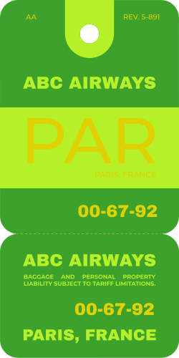



Outline
Problem Statement
Dataset
Feature Description
Data Pre-processing
Modelling Methods
Results
Model Critique
Conclusion

Slide 3
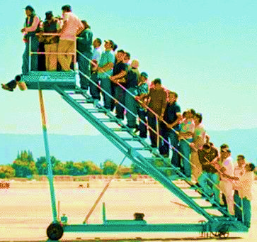
Problem Statement
The surge in Air Travel has resulted in a notable uptick in flight delays, intensifying airport congestion and imposing financial burdens on the airline sector.
These delays not only inconvenience passengers but also impose significant economic burdens, with estimates suggesting annual costs reaching billions of dollars.
Our study endeavors to forecast flight delays to improve both passenger experience and operational efficiency within the aviation industry.

Slide 4
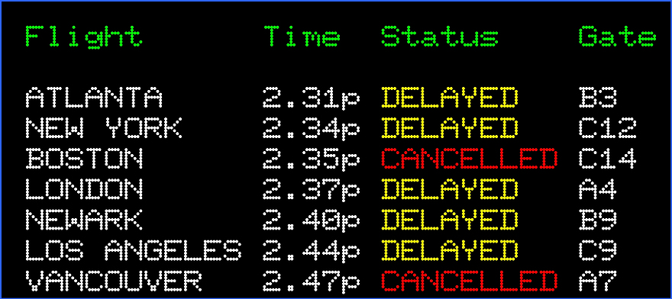
Exploring Airlines Data
Our study utilizes a Kaggle dataset, for the years 2015, to gain insights into the operational challenges and reliability of air transportation services during this timeframe.
The dataset comprises 5 million rows and 28 columns.
It includes Integer, Categorical, and Binary data types, reflecting various essential information crucial for investigating Airline delays.
This includes a broad spectrum covering temporal dynamics, Operational details, Geospatial Information, and delay classifications.
Want to add a point to connect this slide with the pre-processing slide

Slide 5
An Overview – Dataset Features
Categories | Feature Name | Sample Values | Feature Description
DATE & TIME | FL_DATE | 2015-01-01 | The Date of the Flight
 | CRS_DEP_TIME | 2147, 1050, 700 | Schedule Departure Time (HHMM)
 | DEP_TIME | 2147, 1050, 700 | Actual Departure Time (HHMM)
 | CRS_ARR_TIME | 2250, 1404, 757 | Scheduled Arrival time (HHMM)
 | ARR_TIME | 2245., 1403., 813. | Actual Arrival time (HHMM)
FLIGHT DETAILS | OP_CARRIER | 'NK', 'MQ', 'OO', 'EV', ‘HA' | The Name of the Carrier
 | OP_CARRIER_FL_NUM | 195, 197, 198 | Flight Number of the Carrier
 | ORIGIN | 'MCO', 'LGA', 'FLL', 'IAH' | Origin Airport
 | DEST | 'FLL', 'MCO', 'LAS', 'ORD' | Destination airport
 | DISTANCE | 177., 1076., 1222. | Distance between airports (miles)
TIME METRICS | TAXI_OUT | 15., 20., 19., 8. | Taxi Out Time, in Minutes; The time elapsed between departure from the origin airport gate and wheels off.
 | WHEELS_OFF | 2158., 1124., 731. | Wheels Off Time (local time) in HHMM
 | WHEELS_ON | 2158., 1124., 731. | Wheels On Time (local time) in HHMM
 | TAXI_IN | 7., 9., 10., 4., 5. | Wheels down and arrival at the destination airport gate, in minutes
 | CRS_ELAPSED_TIME | 63., 194., 57., 196. | Estimated Elapsed Time of Flight, in Minutes
 | ACTUAL_ELAPSED_TIME | 63., 194., 57., 196. | Elapsed Time of Flight, in Minutes
 | AIR_TIME | 40., 150., 32., 164. | Flight time in Minutes
DELAY INFORMATION | DEP_DELAY | -4., 14., 12. | Difference in minutes between scheduled and actual departure time. Early departures show negative numbers.
 | ARR_DELAY | -5.0, -1.0, 16.0 | Difference in minutes between scheduled and actual arrival time. Early arrivals show negative numbers.
 | CANCELLED | 0., 1. | Cancelled Flight Indicator (1=Yes); was the flight cancelled?
 | CANCELLATION_CODE | 'A', 'B', 'C', 'D' | Reason for cancellation (A = carrier, B = weather, C = NAS, D = security
 | DIVERTED | 0., 1. | Diverted Flight Indicator (1 = Yes)
 | CARRIER_DELAY | 1., 15., 127., 174. | Carrier Delay, in Minutes
 | WEATHER_DELAY | 31., 17., 24., 61. | Weather Delay, in Minutes
 | NAS_DELAY | 16., 18., 25., 19. | National Air System Delay, in Minutes
 | SECURITY_DELAY | 8., 21., 6., 14. | Security Delay, in Minutes
 | LATE_AIRCRAFT_DELAY | 8., 29., 21., 10. | Late Aircraft Delay, in Minutes

Slide 6
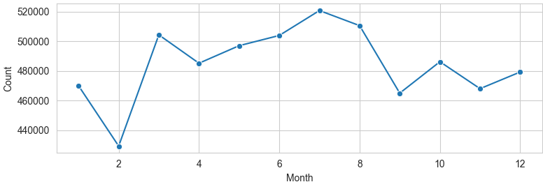
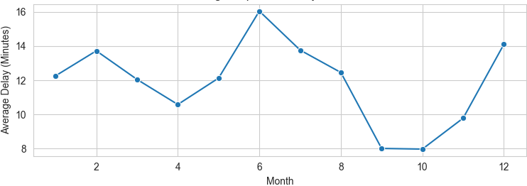

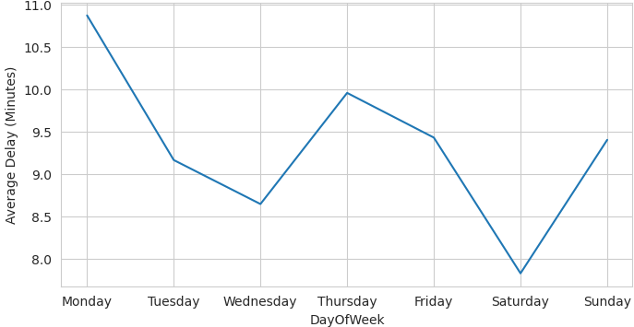
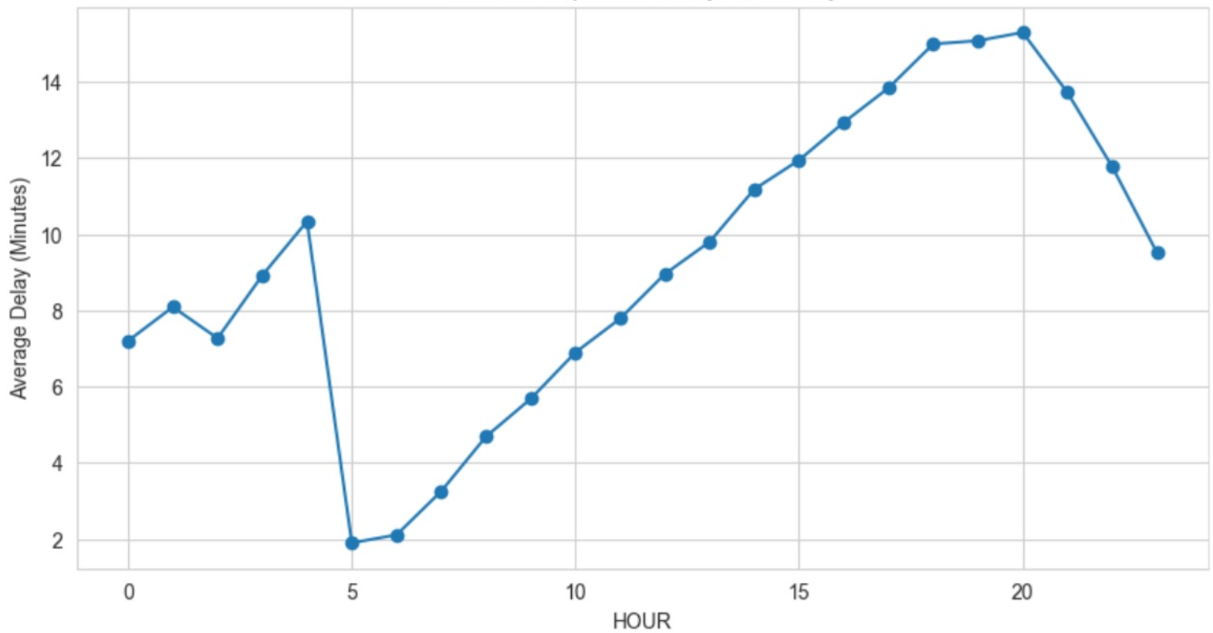
Exploratory Data Analysis
Flight Counts Per Month
Average Departure Delay Per Month
Seasonality shift in the flights count per month
Avg. Departure delay goes well with the seasonality shift
Average Departure Delay Over Day of Weeks
Average Departure Delay Over Days

Slide 7
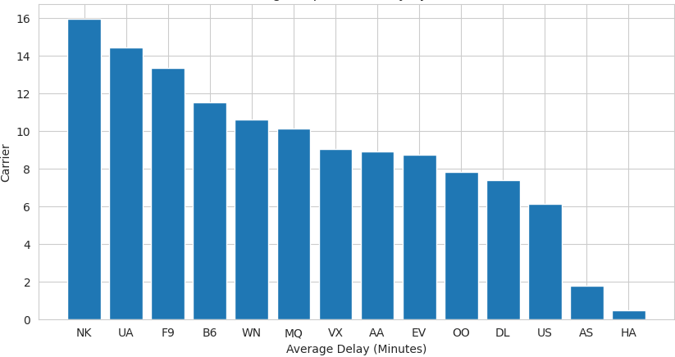
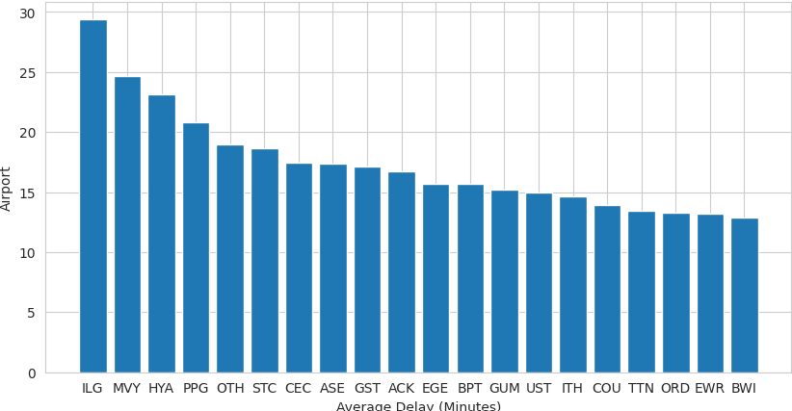
Exploratory Data Analysis – Cont.
Average Departure Delay by Carrier
Top 20 Airports by Average Departure Delay
Provides insights into the punctuality performance of airlines
Highlights potential areas of congestion and operational challenges within the aviation system
Notes:
ILG (Wilmington Airport, Delaware, USA):
Possible reasons for delays: Wilmington Airport is a small regional airport, and smaller airports often have fewer resources and infrastructure to handle flights efficiently. Delays could be due to limited staffing, fewer runways, or less advanced air traffic control systems.
MVY (Martha's Vineyard Airport, Massachusetts, USA):
Possible reasons for delays: Martha's Vineyard Airport serves a popular tourist destination, especially during peak seasons like summer. Increased passenger traffic during these times can lead to congestion, longer queues for takeoff and landing, and overall delays in flight schedules.
HYA (Barnstable Municipal Airport, Massachusetts, USA):
Possible reasons for delays: Similar to Martha's Vineyard Airport, Barnstable Municipal Airport serves a region known for tourism, particularly Cape Cod. Like other tourist destinations, increased seasonal travel can strain airport resources and contribute to delays.
PPG (Pago Pago International Airport, American Samoa):
Possible reasons for delays: Pago Pago International Airport is located in a remote area and serves a relatively small population. Limited infrastructure, adverse weather conditions, and fewer flight options may contribute to delays at this airport.
OTH (Southwest Oregon Regional Airport, Oregon, USA):
Possible reasons for delays: Southwest Oregon Regional Airport is situated in a region known for its rugged terrain and variable weather conditions. Adverse weather, such as fog or high winds, could impact flight operations and result in delays.
NK (Spirit Airlines):
Possible reasons for delays: Spirit Airlines is known for its no-frills, low-cost model, which often involves quick turnarounds between flights. However, this can lead to challenges in maintaining on-time departures, especially if there are any issues with aircraft maintenance, ground operations, or crew scheduling.
UA (United Airlines):
Possible reasons for delays: United Airlines operates a vast network of flights, including many connecting flights at major hubs. Delays can occur due to factors such as air traffic congestion, weather-related disruptions, and operational issues at busy airports.
F9 (Frontier Airlines):
Possible reasons for delays: Frontier Airlines is an ultra-low-cost carrier that focuses on point-to-point travel. Delays may occur due to factors such as limited staffing, quick aircraft turnarounds, and scheduling challenges associated with managing a diverse route network.
B6 (JetBlue Airways):
Possible reasons for delays: JetBlue Airways operates primarily in the eastern United States and the Caribbean, with a focus on customer service and amenities. Delays may occur due to factors such as weather-related disruptions, airspace congestion, and operational challenges at busy airports like New York's JFK.
WN (Southwest Airlines):
Possible reasons for delays: Southwest Airlines is one of the largest low-cost carriers in the world, known for its point-to-point service model and high frequency of flights. Delays may occur due to factors such as air traffic congestion, weather-related disruptions, and operational issues at busy airports.

Slide 8
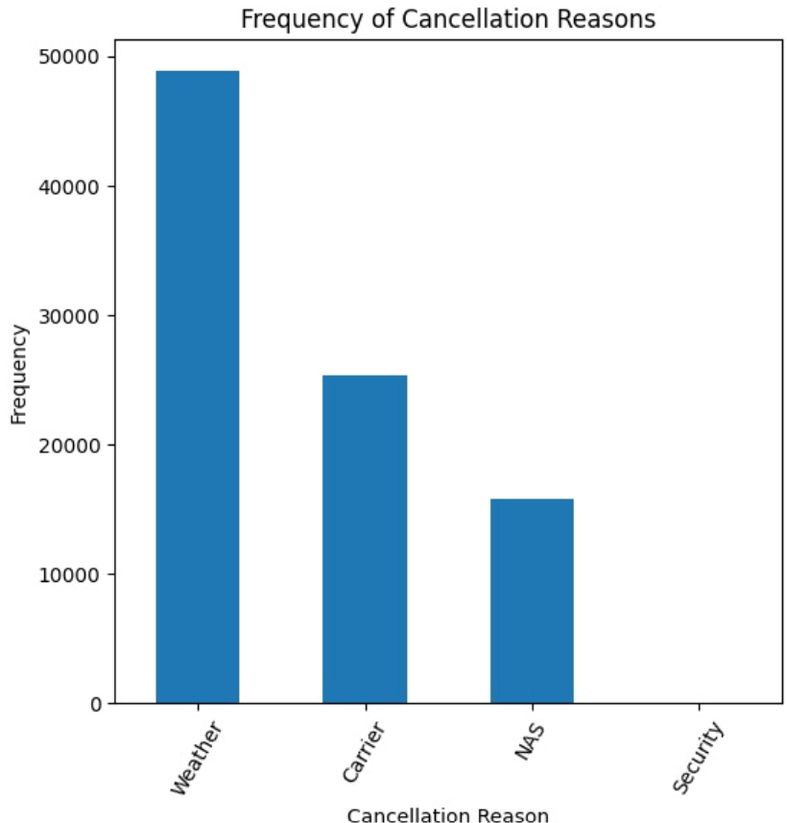
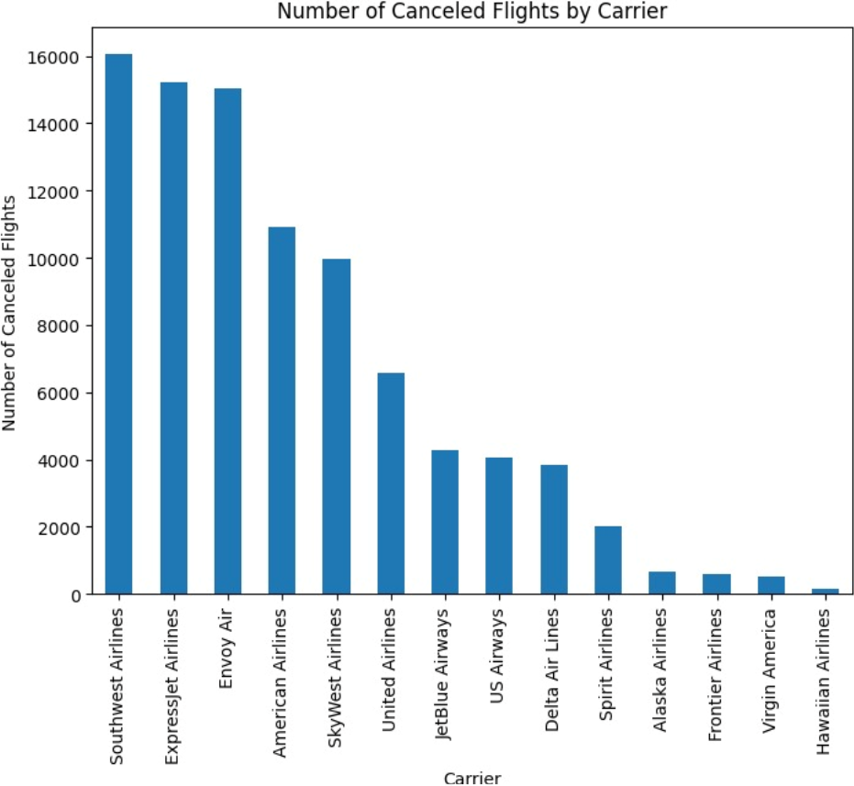
Exploratory Data Analysis – Cont.
Airline Cancellation Analysis
dfadasdda

Slide 9





Exploratory Data Analysis – Cont.
NOT REQUIRED FEATURES
IMPORTANT FEATURES
FLIGHT NUMBER
FLIGHT DATE
DESTINATION
CARRIER
DEPARTURE TIME
ORIGIN
SCHEDULED DEPARTURE TIME
CANCELLATION CODE
DIVERTED
DEPARTURE DELAY
ARRIVAL RELATED FEATURED
TYPES OF DELAYS
Notes:
For Simple Explanation: EDA involves examining and understanding the structure, patterns, and relationships within the dataset. We explore the columns, check for missing values, identify unusual observations like: instances of exceptionally long delays or cancellations that deviate significantly from the normal delay time.

Slide 10
Data pre-processing Techniques
Category | Techniques |  | Sample Features
Scraped weather data(lots of unique origin airports, diff preproc, origin represents the location->weather) Ohe on hour of day, dayofweek and carrier Extracting time features from datetime

Slide 11
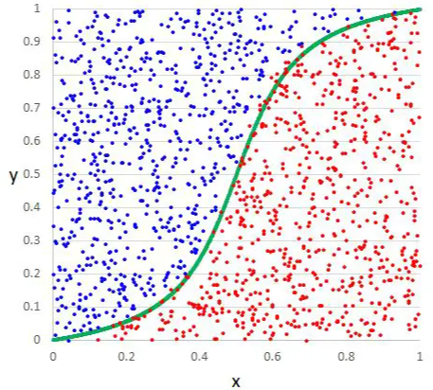
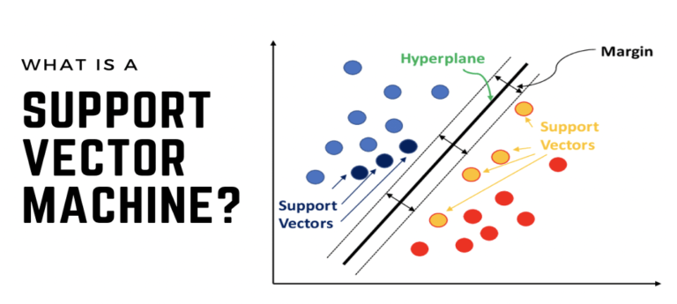
Modeling Approaches
Logistic Regression
Draws a S curve to separate things into two groups based on their features and predicts the probability of belonging to each group
Support Vector Machine
Classifies instances by drawing boundaries around each group using support vectors, optimizing to find the widest gap between the boundaries to separate the groups.
Notes:
Logistic regression:
So, when we want to sort a new thing, it looks at its features and guesses which group it might belong to based on where it falls on the line.
It looks at the characteristics of each fruit and tries to draw a line (or boundary) between apples and oranges based on those characteristics. This line helps us separate the two groups.
But here's the twist: Instead of just drawing a straight line, logistic regression uses a special kind of curve called the "S-curve." This curve allows logistic regression to not only separate the fruits into two groups but also to give us the probability that each fruit belongs to one group or the other.
So, when we use logistic regression to classify a new fruit, it looks at its characteristics and calculates the probability that it's an apple or an orange based on where it falls on the S-curve.
In simple terms, logistic regression helps us classify things into two groups (like apples and oranges) by drawing a curve that shows the probability of belonging to each group based on their characteristics.
Svm- When we have a new instance to classify, SVM looks at its features and sees which side of the boundary it falls on to predict its group.
Decision Trees:
Imagine you're trying to make a decision, and you have a bunch of questions you could ask to help you decide. For example, if you're deciding what to wear, you might ask questions like "Is it raining?" or "Is it hot outside?" Each question helps you narrow down your choices until you make a decision.
A decision tree works similarly. It asks a series of questions about the data and uses the answers to classify or predict something. Each question splits the data into smaller groups, and the process continues until it reaches a conclusion, like whether a customer will buy a product or not.
Random Forests:
Now, think of a forest with many trees. Each tree (decision tree) in the forest is like a different person making a decision based on their own set of questions. Some people might focus more on the weather, while others might care more about the occasion.
Similarly, a random forest is a collection of decision trees. But here's the key: each tree in the forest is trained on a different subset of the data and asks different questions. When you want to make a prediction, you ask each tree in the forest and take a vote. The most popular prediction among the trees becomes the final prediction.
In simple terms, Decision Trees are like individual decision-makers, while Random Forests are like a diverse group of decision-makers working together to decide.

Slide 12
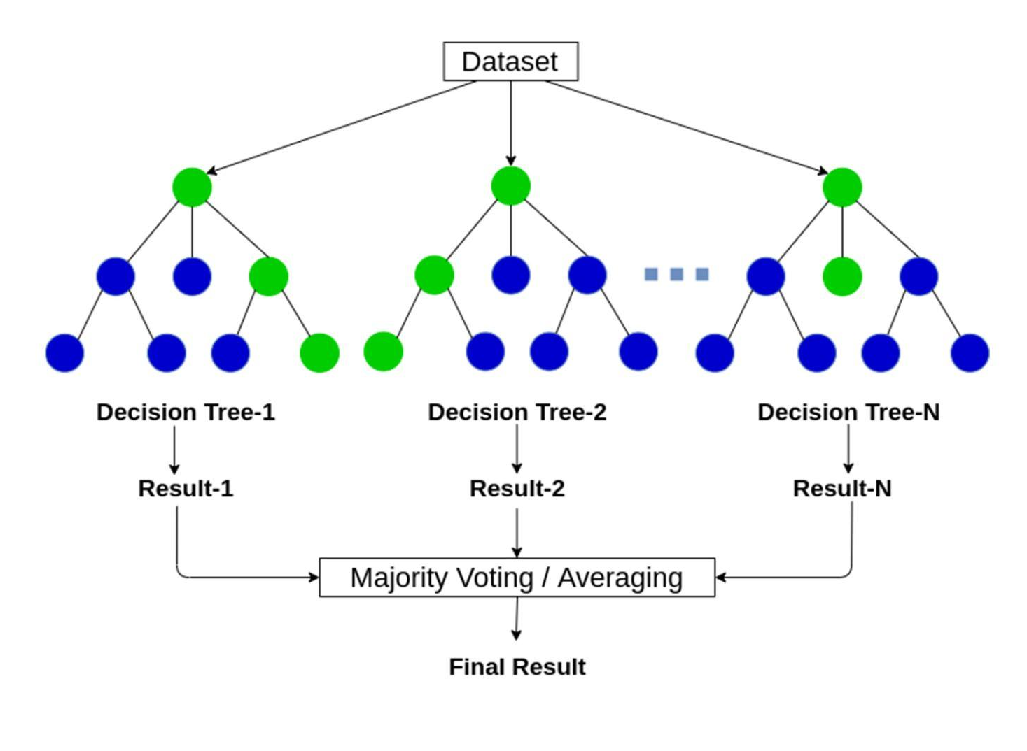
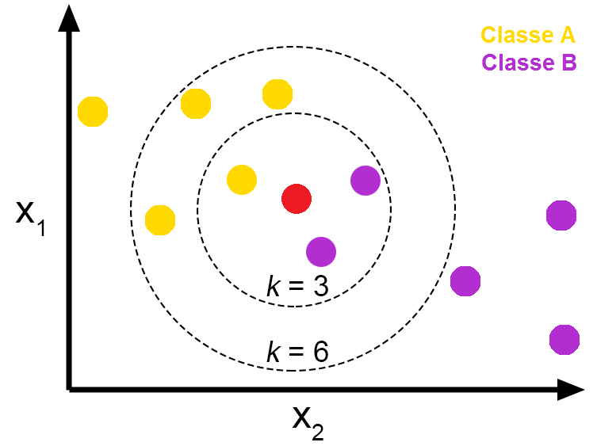
Modeling Approaches
Random Forest
Decision Tree analyzes data features, asking questions to classify data points into categories, while in random forest, multiple decision trees collaborate, with the final prediction based on the most common decision among them.
XGBoost
Trains multiple decision trees, each learning from the mistakes of its predecessors to improve accuracy, ultimately combining their predictions for optimal results
K Nearest Neighbour
Categorizes new instances by comparing them to a set number of nearby instances and assigning the most common label among these neighbors to the new instance.
Notes:
Knn- For instance, if the majority of nearby instances have a label of 1, we predict that the new instance will likely have the same label.
KNN: Imagine you have a group of friends who have different personalities, and you want to make a new friend who matches your interests. Now, you don't know much about this potential friend, but you do know a lot about your current friends.
KNN works kind of like this: It looks at your new friend's traits (like interests or hobbies) and compares them to your existing friends. The "K" stands for how many of your closest friends you want to consider. So, KNN finds the "K" friends who are most like your new friend in terms of their traits.
Once it finds those similar friends, it looks at how they feel about something (maybe a movie or a book). Then, it predicts how your new friend might feel about the same thing based on how their traits match up with your existing friends.
Decision Trees:
Imagine you're trying to make a decision, and you have a bunch of questions you could ask to help you decide. For example, if you're deciding what to wear, you might ask questions like "Is it raining?" or "Is it hot outside?" Each question helps you narrow down your choices until you make a decision.
A decision tree works similarly. It asks a series of questions about the data and uses the answers to classify or predict something. Each question splits the data into smaller groups, and the process continues until it reaches a conclusion, like whether a customer will buy a product or not.
Random Forests:
Now, think of a forest with many trees. Each tree (decision tree) in the forest is like a different person making a decision based on their own set of questions. Some people might focus more on the weather, while others might care more about the occasion.
Similarly, a random forest is a collection of decision trees. But here's the key: each tree in the forest is trained on a different subset of the data and asks different questions. When you want to make a prediction, you ask each tree in the forest and take a vote. The most popular prediction among the trees becomes the final prediction.
In simple terms, Decision Trees are like individual decision-makers, while Random Forests are like a diverse group of decision-makers working together to decide.
RF- but each focuses on different aspects of the data. When making a prediction, each tree contributes its decision, and the

Slide 13
Model Improvements
Notes:
is like adding guardrails to a road to prevent cars from veering off-track, ensuring they stay on the right path without going too far in any direction.
Grid Search CV is like trying out different routes on a map to find the quickest way to your destination, testing various combinations until you discover the most efficient route.

Slide 14

Results
Model | Accuracy% | Precision | Recall | F1 Score
Logistic Regression
Random Forest
SVM
KNN
XGBoost

Slide 15
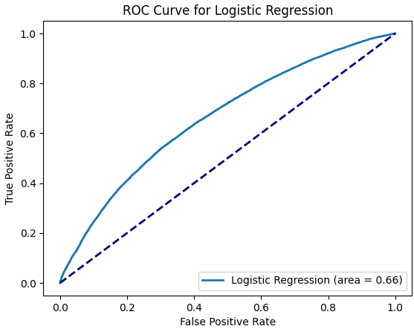
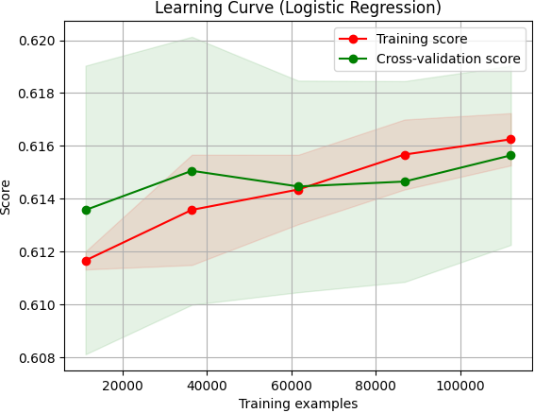
Result Analysis – Logistic Regression
Area of Residual Graph: 66%
Accuracy: 62%

Slide 16
Result Analysis –Support Vector Machine
Area of Residual Graph:
Accuracy: %

Slide 17
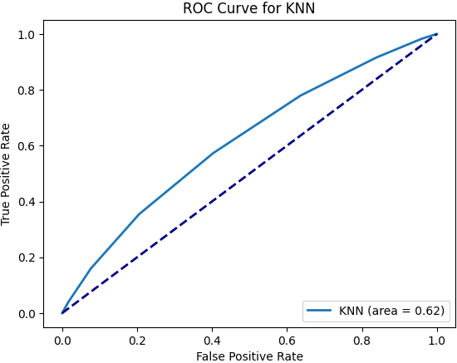
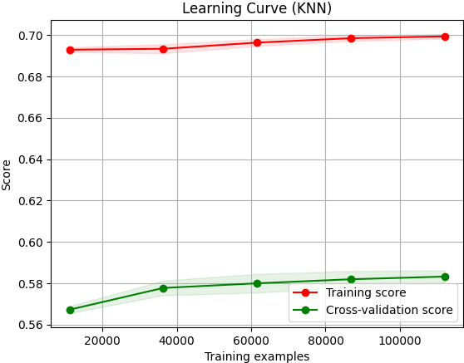
Result Analysis – K-Nearest Neighbour
Area of Residual Graph: 62%
Accuracy: 60%

Slide 18
Result Analysis – Random Forest
Area of Residual Graph:
Accuracy: %

Slide 19
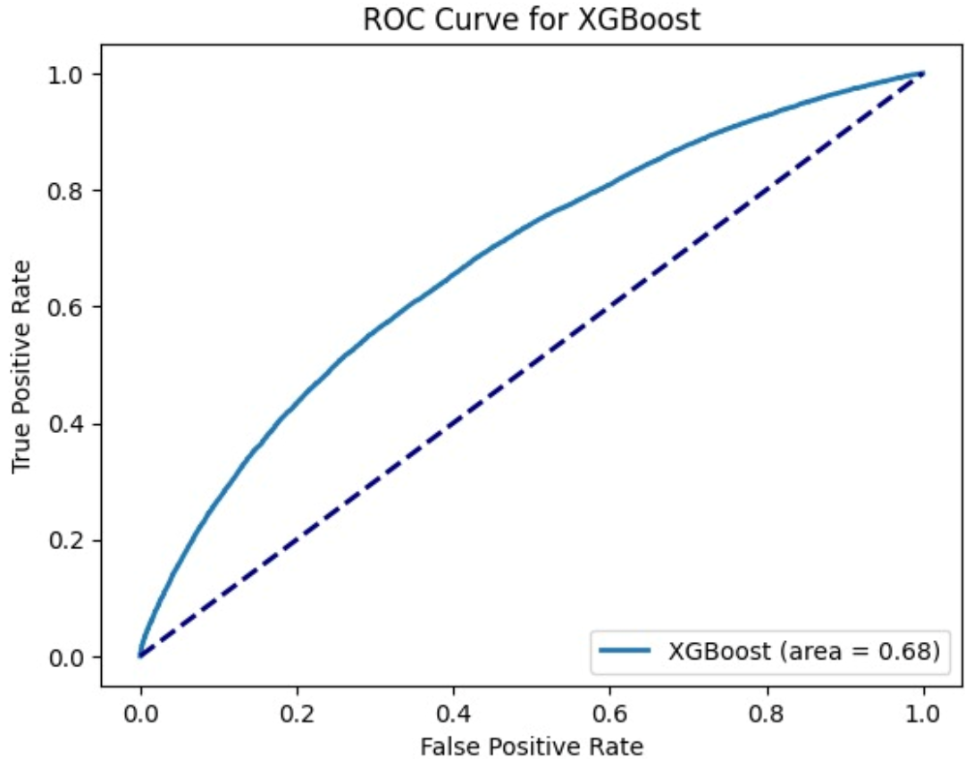
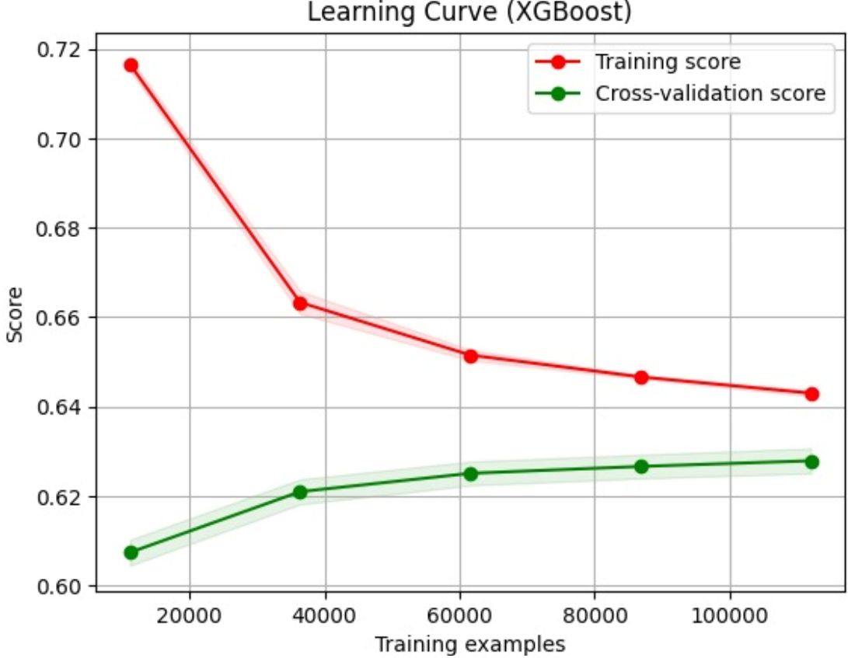
Result Analysis – XGBoost(HyperOpt)
Area of Residual Graph:
Accuracy: 63%

Slide 20
Analysis and Interpretation
XGBoost model boasts an impressive 88% accuracy, ensuring reliable identification and management of flight delays for enhanced operational efficiency and passenger satisfaction.
Strategic Planning: The model offers insights for strategic planning in the airline industry, enabling optimization of operations, route planning, and resource allocation to improve efficiency and customer satisfaction.
Resource Allocation: Accurate predictions empower airlines to optimize resource allocation, including staffing, maintenance schedules, and fuel management, reducing costs and enhancing profitability.
We recommend implementing targeted strategies to mitigate delays, such as adjusting flight schedules for routes prone to delays and allocating additional resources to expedite turnaround times.
Additionally, proactive measures, like investing in preventive maintenance programs, can address underlying issues and improve operational efficiency to minimize delays and enhance passenger satisfaction.

Slide 21
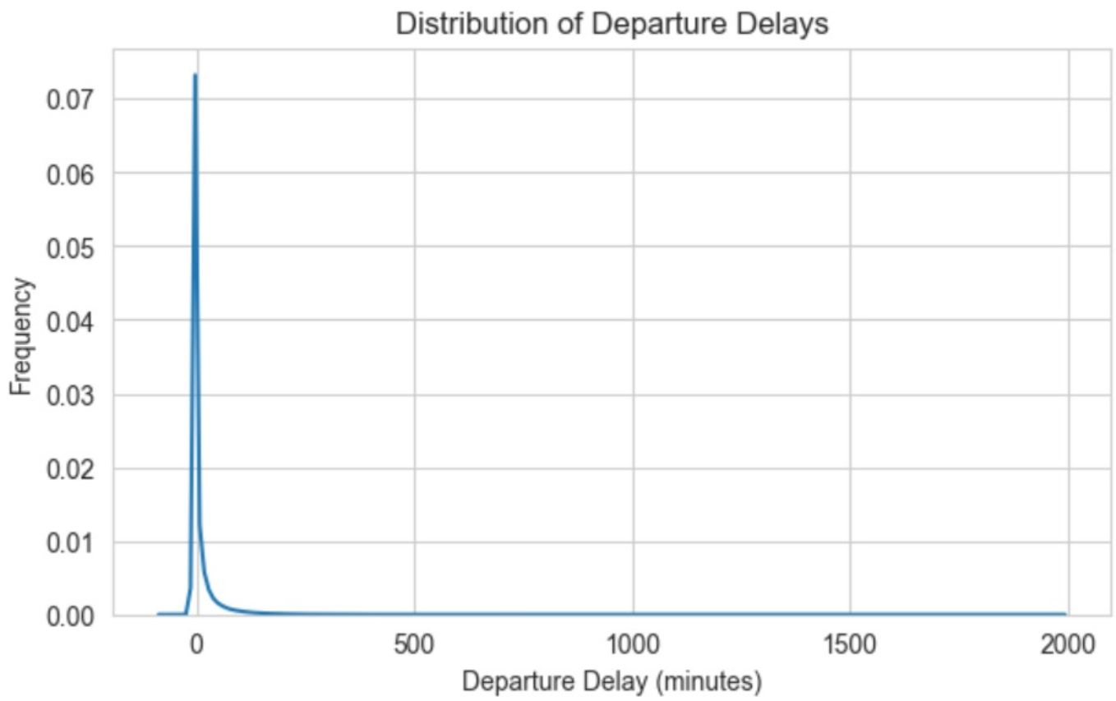
Model Critique
Does the model satisfactorily answer the questions posed?
Regression model did.. And then it didn’t work out because of unavailability of critical data responsible for delays like weather delay, NAS delay etc. Referring to the plots of cancellation, referring to the plot below and then we switched to Classification.
Discuss the limitations of the model, possibilities to improve the model, etc.
Since we have one-year data close to 5 million records comprising of multiple airports and airlines, it took hours to train the model, and to improve the performance of model, we added Hyper Parameter tuning that extends the hours.
We could improve this by considering the model to train the data related to an airport or airline.

Slide 22
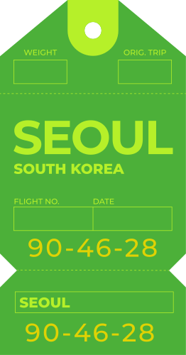


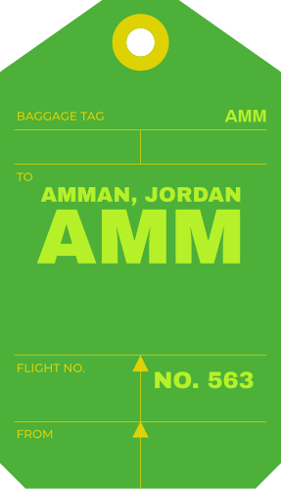
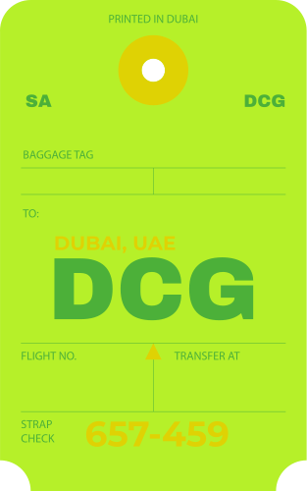

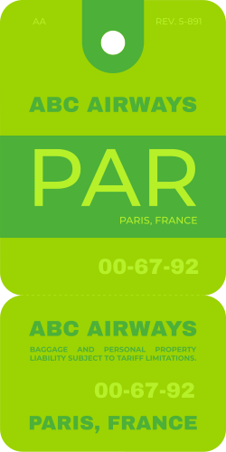

Conclusion

Slide 23
References
SVM- https://datatron.com/what-is-a-support-vector-machine/
Random forest- https://anasbrital98.github.io/blog/2021/Random-Forest/
KNN- https://towardsdatascience.com/knn-k-nearest-neighbors-1-a4707b24bd1d

Slide 24
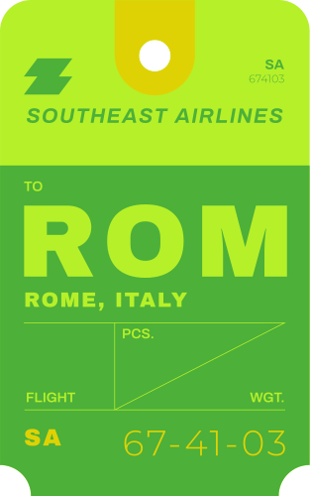


Thank you!

Slide 25
Exploratory Data Analysis – Cont.
Average Departure Delay Over Days
Delays are less common during early morning flights but become more frequent in the late afternoon and evening, likely due to increasing air traffic and accumulated delays.

Slide 26
Exploring Airlines Data
Our study utilizes a Kaggle dataset, for the year 2015, to gain insights into the operational challenges and reliability of air transportation services during this timeframe.
The dataset comprises 5 million rows and 28 columns.
It includes Integer, Categorical, and Binary data types, reflecting various essential information crucial for investigating Airline delays.
This includes a broad spectrum covering temporal dynamics, Operational details, Geospatial Information, and delay classifications.
Want to add a point to connect this slide with the pre-processing slide

Slide 27
Evaluation Metrics
Classification Report:
Precision: How many of the items predicted as positive are indeed positive.
Recall: How many of the actual positive items were predicted correctly.
F1 Score: Balance between precision and recall.
Accuracy: How often the model's predictions are correct overall.
AUC-ROC Curve: Illustrates how well the model can tell apart positive from negative cases by comparing how often it correctly identifies positive cases with how often it incorrectly identifies negative cases.
Learning Curve: Learning curve shows how well a model improves as it gets more training. The graph that tracks the performance metric with the size of the training dataset. It helps understand if the model is getting better with more data and if it needs more training or if it's already good enough.
Notes:
Higher values on the curve indicate better performance in distinguishing between the two classes.

Slide 28
EXTRA SLIDE
Random Forest:
Analyzes data features, asking questions to classify data points into categories, while in a random forest, multiple decision trees collaborate, with the final prediction based on the most common decision among them.
XGBoost:
Trains multiple decision trees, each learning from the mistakes of its predecessors to improve accuracy, ultimately combining their predictions for optimal results.
KNN (K-Nearest Neighbors):
Categorizes new instances by comparing them to a set number of nearby instances and assigning the most common label among these neighbors to the new instance.

